Slide 1
Distributed File System
Google File System
Notes:
Hi,
Today I’m going to talk about the Google file system.

Slide 2
DFS
Single node architecture that looked at data fitting in memory
Advanced to: data on disk and processing part of it as you bring into memory
Consider larger files with more processing needed

Slide 3
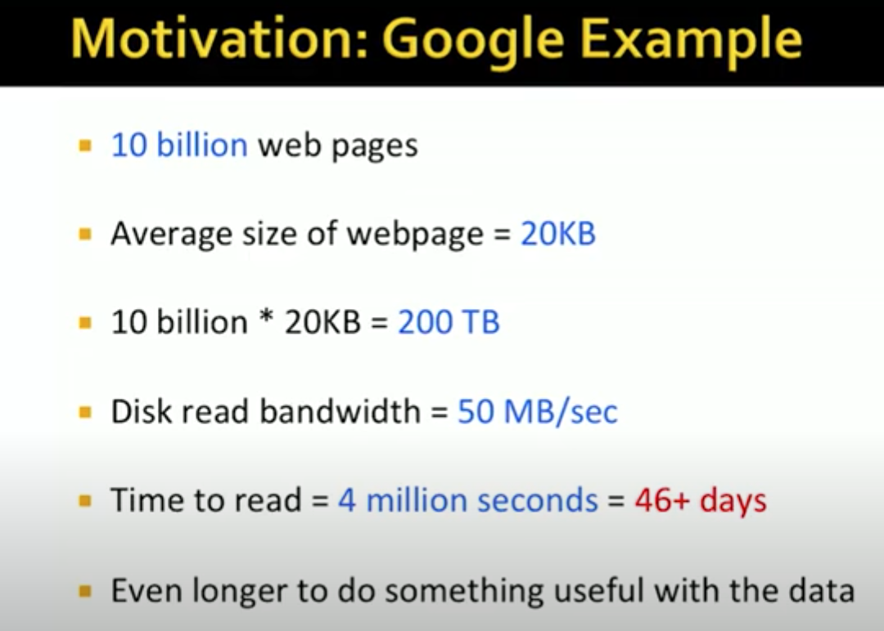
Split data into chunks and use multiple disks and CPUs.
Say 1000 CPU’s then can do in 4000 s … an hour
Notes:
1 billion = 10,000 lakhs

Slide 4
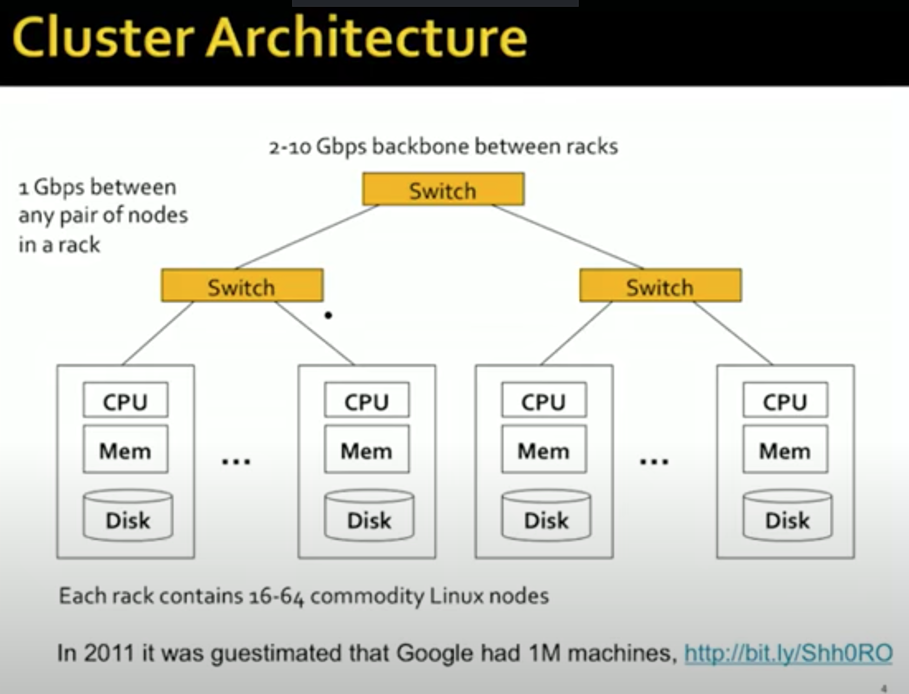
Notes:
10Gbps ia 10 giga bits per second =1.25 Giga bytes per second

Slide 5
Challenges
Nodes can fail. If a node doesn’t fail for 3 years (1000 days) then with 1M servers will give 1000 failures per day
Persistent data not possible if data lost on node failure
Availability compromised if nodes fail
Network can be bottleneck so should not move data around too much.
Complexity of distributed programming

Slide 6
Solutions :
DFS: takes care of storing data taking care of redundancy and availability
HDFS, GFS

Slide 7
Huge data so sharding needed
If sharding over so many machines then few will always be down -> Hence replicas needed
If replicas -> have to take care they are consistent
Consistency compromises on performance

Slide 8

The File System
Sanjay Ghemawat, Howard Gobioff,
Shun-Tak Leung
(Google)
Notes:
Hi,
Today I’m going to talk about the Google file system.

Slide 9
GFS Motivation
Need for a scalable DFS
Large distributed data-intensive applications
High data processing needs
Performance, Reliability, Scalability and Availability
More than traditional DFS
Notes:
Geogle people often deal with very large distributed data-intensive applications which require very high data processing. So, they want a file system that can meet these requirements efficiently. The GFS shares the same goals with other DFSs, for example, performance, reliability, scalability and available, but it is more than that:

Slide 10
Assumptions –
Environment
Commodity Hardware
  inexpensive
Component Failure
  the norm rather than the exception. application bugs, OS bugs, failures of disks/memory/connectors/networking/power supplies.
TBs of Space
  must support TBs of space
Notes:
When designing the filesystem, Google people makes the following assumptions about the environment
First, The system is built from inexpensive hardware components
The second assumption is that component failures, that is, hardware failures, software failures, OS failures are the norm rather than the exception
As their data is quite huge, the file system should work efficiently with terabytes of storage.

Slide 11
Assumptions –
Applications
Multi-GB files
  Common
Workloads
  Large streaming reads
  Small random reads
  Large, sequential writes that append data to file
  Multiple clients concurrently append to one file
High sustained bandwidth
  More important than low latency
Notes:
In their applications, files are very big, up to multi-GB files.
Bandwidth: rate at which data flows over the network.
Latency: time that elapses between a request for information and its arrival.
Basically the workloads consist of two types of reads: large streaming reads and small random reads. Also, they have large, sequential writes that append data to file.
High sustained bandwidth is more important than low latency. Most of our target applications place a premium on processing data in bulkat a high rate, while few have stringent response time requirements for an individual read or write.
The file system should have high sustained bandwidth rather than low latency for an individual read or write.
Low latency describes a computer network that is optimized to process a very high volume of data messages with minimal delay (latency). These networks are designed to support operations that require near real-time access to rapidly changing data

Slide 12
Architecture
Files are divided into chunks
Fixed-size chunks (64MB)
Replicated over chunkservers, called replicas
Unique 64-bit chunk handles
Chunks as Linux files
Notes:
To deal with large files, GFS divides files into chunks.
Each chunk has a fixed-size of 64MB and is replicated over a number of machines, called chunkservers.
These copies are called replicas.
Each chunk has a unique 64-bit chunk handles and is stored as Linux files on the disk.

Slide 13
Architecture
Single master
Multiple chunkservers
  Grouped into Racks
  Connected through switches
Multiple clients
Master/chunkserver coordination
  HeartBeat messages
Notes:
Google may have many clusters
Each cluster has a single master and multiple chunkservers which are divided into racks.
Racks are connected through switches
Multiple clients interact with the master to find the locations of chunkservers
The interaction between master and chunkservers is through heartbeat messages.

Slide 14
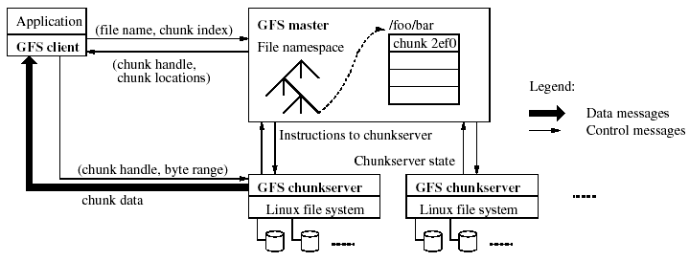
Architecture
Contact single master
Obtain chunk locations
Contact one of chunkservers
Obtain data
Notes:
A cluster consists of
A single master
Multiple chunkservers
Multiple clients
Let’s how a client reads a file
First, the client sends the filename and chunk index to the master
The master will look up the filenamespace to fine the chunk handle and the locations of its replicas.
The chunk handle and chunk locations are sent back to the client
The client picks up a chunkserver and uses chunk handle to read the data.
Heartbeat messages are used for the interaction between master and chunkservers

Slide 15
Master
Metadata
  Three types
    File & chunk namespaces(handles) --logged
    Mapping from files to chunks -logged
    Locations of chunks’ replicas(if master dies it restarts and asks chunk servers as to what they have because chunk server disks too may spoil or go bad losing chunk information), version number of each(logged), primary replica, expiration time.
  Replicated on multiple remote machines
  Kept in memory
Operations
  Replica placement
  New chunk and replica creation
  Load balancing
  Unused storage reclaim
Notes:
DFS Namespaces is a role service in Windows Server that enables you to group shared folders located on different servers into one or more logically structured namespaces.
The metadata is contained in the master and is replicated on multiple remote machines.
There are 3 types of metadata: file and chunk namespaces, tables mapping from files into chunks and locations of chunk replicas.
For performance, meta data is stored in memory.
Master performs the following operations
makes decision about replica replacement
manage new chunk and replica creations
Maintain load balances between chunkservers within the same rack and even over different racks
Reclaim unused storage if necessary

Slide 16
Flow
Client using the fixed chunksize, translates the file name and byte offset specified by the application into a chunkindex within the file.
Then, it sends the master a request containing the file name and chunk index.
The master replies with the corresponding chunk handle and locations of the replicas. The client caches this information using the file name and chunk index as the key.
The client then sends a request to one of the replicas specifying the chunk handle and a byte range within that chunk.

Slide 17
Operations
  Replica placement :
  Chunk replicas are spread across racks so that chunks survive even if racks damaged or offline.
  Unused storage reclaim :
  File deleted by application is marked and renamed to hidden file. Files hidden for three days are removed during regular scan by master.
  Similarly orphaned chunks (those not reachable by any file) are removed.
  In a HeartBeat message regularly exchanged with the master, each chunkserver reports the chunks it has, and the master replies with the identity of all chunks that are no longer present in the master’s metadata. The chunkserver is free to delete its replicas of such chunks.

Slide 18
Operations:
New chunk and replica creation :
  Want to place chunks on servers with less than average disk space utilization. Because typically chunks are created when a write operation is to follow.
  Replication created when number of replicas less than 3 if current replica is unavailable or reported to have errors or corrupted or replication need goes up.
  Which ones to replicate first depends on how many replicas left, which files live,which is blocking client pipeline, etc.
  master selects new chunkserver balancing load and on different rack and asks it to copy from valid replica
  the master rebalances replicas periodically: it examines the current replica distribution and moves replicas for better diskspace and load balancing.

Slide 19
Read
Client Asks master with filename and offset
For each chunk: Master responds with chunk handle and chunk replica servers
Client caches all this information for repeated use
Client contacts one of chunk servers to get the data.

Slide 20
Implementation –
Consistency Model
Relaxed consistency model
Two types of mutations
  Writes
    Cause data to be written at an application-specified file offset
  Record appends
    Operations that append data to a file
    Cause data to be appended atomically at least once
    Offset chosen by GFS, not by the client
States of a file region after a mutation
  Consistent
    All clients see the same data, regardless which replicas they read from
  Defined
    consistent + all clients see what the mutation writes in its entirety
  Undefined
    consistent +but it may not reflect what any one mutation has written
  Inconsistent
    Clients see different data at different times
Notes:
GFS employs a relaxed consistency model
GFS defines two types of mutations
Writes cause data to be written to a specific location specified by the application
Record appends cause data to be written at an offset chosen by GFS. GFS ensures that data is written atomically at least once. I will talk about the append-at-least-once semantics later.
GFS’s consistency model is based on the definition of states of a file region after mutation
A file region is said to be consistent if all clients see the same data, regardless which replicas they read from.
In addition, if all clients see what the mutation writes in its entirety, it is defined. A file region is in undefined state if it is consistent but it doesn’t reflect what any one mutation has written
Otherwise, it will be inconsistent, that is, different clients see data at different times

Slide 21
Write
Client asks master replica information which he caches. Also gives primary and secondary information.
If no primary then find uptodate replicas (by version number and make one primary). Tell client of primary and secondary servers among replicas. Increment version number of all
Inform version number to Primary and secondaries . Master then updates version number
Primary picks the offset and informs secondaries to append at same location
Client sends data to replicas. Linearly closest one first data is passed. Data stored in cache in all replicas.
Once all replicas acknowledge receiving data: client sends primary write request. Primary gives serial number to all write requests to execute them in order. Executes himself and sends requests to secondaries.

Slide 22
Write
Secondary executes writes in serial order and confirms back to primary.
If primary gets a yes from everyone about having appended then primary returns success to client. Else returns no to client(data region is inconsistent) who restarts the procedure.

Slide 23
What can go wrong
Serial writes – defined.
Primary succeeded to write but secondary did not – inconsistent data
Concurrent writes - If everyone says yes- consistent but still could be undefined because of below:
- Concurrent writes – each gets a start index concurrently but the streaming data though written serially from concurrent writes may overwrite data making it consistent but undefined
- Large appends or data that straddles a chunk boundary may make this happen.
Notes:
Case1:
Say for file1 replicas are in CS1 and CS2 and two clients 1 and 2 are wanting to write
Now, primary of file1 wants write to location 10. he does not know how much data is coming in. Meanwhile client 2 requested write and primary gave location as location 12
While both writes are successful, the write of client1 has overlapped the write of client 2 or vice versa. Hence writing was consistent but undefined.
Case2:
Say for file1 replicas are in CS1 and CS2 while for file 2 replicas are in CS2 and CS3.
Now, primary of file1 is CS1 and for file 2 is CS3.
CS1 said write at location 10 and CS3 said write at location 12 (as he is now aware of CS1’s write).
While both writes are successful, the write of file 2 at CS2 has overlapped the write of file1 or vice versa. Hence writing was inconsistent

Slide 24
If a mutation is not interrupted by another concurrent mutation then data is defined
If Mutation is interrupted by another concurrent mutation since mutation 1 was given start position index x1 and mutation 2 was given index x2 then mutation1 did not have space to write out entirely what it wanted to. In such a case we have undefined data or mingled fragments

Slide 25
Can have duplicates (content repeated)
Can have blank spaces
Can have data in only two of 3 replicas if client dies

Slide 26
Implementation –
Leases and Mutation Order
Master uses leases to maintain a consistent mutation order among replicas
Primary is the chunkserver who is granted a chunk lease
All others containing replicas are secondaries
Primary defines a mutation order between mutations
All secondaries follows this order
Notes:
GFS obtains consistency between replicas by using leases and defining a mutation order between mutations.
If a chunk is about to be modified, the chunkserver that is currently holding the lease for that chunk will be called primary. If no chunkserver has that lease, the master will choose one chunkserver that contains a chunk replica to be primary and grant the lease for that chunkserver. All other chunkservers that have a replica of the chunk are called secondary.
After the primary gets the lease, it will define an order in which mutations will be written to the disk.
All secondaries will follow this order to write mutations to the chunk.

Slide 27
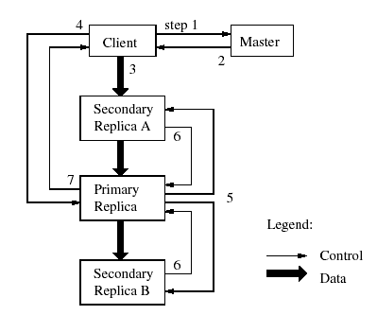
Implementation –
Writes
Mutation Order
identical replicas
File region may end up containing mingled fragments from different clients (consistent but undefined)
Notes:
Here is what happens to when one client wants to perform a write to a chunk.
First client asks master who is holding the lease for that chunk.
The master replies with the primary identity and locations of secondaries
The client will then send data to primary and secondaries in the order it specifies
Next, it sends a write request to the primary
Primary forwards this write request to all secondaries
After the secondaries finish writing the data to the chunk, they send replies to the primary
The primary sends back a reply to the client to inform that all replicas have been modified.
By defining mutation order, GFS ensures that all replicas are identical after writes. However, when there are concurrent writes, the file region may end up containing fragments from different clients.
[Example]
8. If primary had failed then secondary could not have been given an order to work with. If secondary fails then primary asks client to retry
Our goals are to fully utilize each machine’s networkbandwidth, avoid networkbottlenecks and high-latency links, and minimize the latency to push through all the data so data pushed in a pipelined fashion to all nodes.

Slide 28
Implementation –
Atomic Appends
The client specifies only the data
Similar to writes
  Mutation order is determined by the primary
  All secondaries use the same mutation order
GFS appends data to the file at least once atomically
  The chunk is padded if appending the record exceeds the maximum size → padding
  If a record append fails at any replica, the client retries the operation → record duplicates
  File region may be defined but interspersed with inconsistent
Notes:
Similar things happen to the record appends operation
However, there is a little bit difference
If the record exceeds the maximum size of the chunk, GFS will pad the current chunk and returns the location of next chunk to the client. The client will try record appending to this location
If appending record fails is fails at any replica, the client will try the operation, which may lead to duplication of records
This technique may cause the file region to be defined but interspersed with inconsistent regions
[Example]

Slide 29
When data does not fit
When data won’t fit in last chunk:
– Primary fills current chunk with padding
– Primary instructs other replicas to do same – Primary replies to client, “retry on next chunk”
• If record append fails at any replica, client retries operation
– So replicas of same chunk may contain different data
—even duplicates of all or part of record data

Slide 30
Other Issues –
Data flow
Pipelined fashion
    Data transfer is pipelined over TCP connections
    Each machine forwards the data to the “closest” machine
Benefits
  Avoid bottle necks and minimize latency

Slide 31
Other Issues –
Garbage Collection
Deleted files
  Deletion operation is logged
  File is renamed to a hidden name, then may be removed later or get recovered
Orphaned chunks (unreachable chunks)
  Identified and removed during a regular scan of the chunk namespace
Stale replicas
    Chunk version numbering

Slide 32
Implementation –
Operation Log
contains historical records of metadata changes
replicated on multiple remote machines
kept small by creating checkpoints

Slide 33
Other Issues –
Replica Operations
Creation
  Disk space utilization
  Number of recent creations on each chunkserver
  Spread across many racks
Re-replication
  Prioritized: How far it is from its replication goal…
  The highest priority chunk is cloned first by copying the chunk data directly from an existing replica
Rebalancing
  Periodically

Slide 34
Other Issues –
Fault Tolerance and Diagnosis
Fast Recovery
  Operation log
  Checkpointing
Chunk replication
  Each chunk is replicated on multiple chunkservers on different racks
Master replication
  Operation log and check points are replicated on multiple machines
Data integrity
  Checksumming to detect corruption of stored data
  Each chunkserver independently verifies the integrity
Diagnostic logs
  Chunkservers going up and down
  RPC requests and replies

Slide 35
Current status
Two clusters within Google
  Cluster A: R & D
    Read and analyze data, write result back to cluster
    Much human interaction
    Short tasks
  Cluster B: Production data processing
    Long tasks with multi-TB data
    Seldom human interaction

Slide 36
Implications for Applications
Applications can use checksums to decide which areas readers can access
Primary could work on identifying that this is an old failed request and try assigning same number
Can eliminate damanged secondaries permanently
If primary crashes after sending information to some secondaries then they should sync up
In read: read can happen from any replica including secondary. Secondary could be stale.

Slide 37
Measurements
Read rates much higher than write rates
Both clusters in heavy read activity
Cluster A supports up to 750MB/read, B: 1300 MB/s
Master was not a bottle neck
Cluster | A | B
Read rate (last minute) Read rate (last hour) Read rate (since restart) | 583 MB/s 562 MB/s 589 MB/s | 380 MB/s 384 MB/s 49 MB/s
Write rate (last minute) Write rate (last hour) Write rate (since restart) | 1 MB/s 2 MB/s 25 MB/s | 101 MB/s 117 MB/s 13 MB/s
Master ops (last minute) Master ops (last hour) Master ops (since restart) | 325 Ops/s 381 Ops/s 202 Ops/s | 533 Ops/s 518 Ops/s 347 Ops/s

Slide 38
Implementation –
Snapshot*
Goals
  To quickly create branch copies of huge data sets
  To easily checkpoint the current state
Copy-on-write technique
  Metadata for the source file or directory tree is duplicated
  Reference count for chunks are incremented
  Chunks are copied later at the first write

Slide 39
Measurements
Recovery time (of one chunkserver)
  15,000 chunks containing 600GB are restored in 23.2 minutes (replication rate ≅ 400MB/s)

Slide 40
Review
High availability and component failure
  Fault tolerance, Master/chunk replication, HeartBeat, Operation Log, Checkpointing, Fast recovery
TGs of Space
  100s of chunkservers, 1000s of disks
Networking
  Clusters and racks
Scalability
  Simplicity with a single master
  Interaction between master and chunkservers is minimized

Slide 41
Review
Multi-GB files
  64MB chunks
Sequential reads
  Large chunks, cached metadata, load balancing
Appending writes
  Atomic record appends
High sustained bandwidth
  Data pipelining
  Chunk replication and placement policies
  Load balancing

Slide 42
Benefits and Limitations
Simple design with single master
Fault tolerance
Custom designed
Only viable in a specific environment
Limited security

Slide 43
Conclusion
Different than previous file systems
Satisfies needs of the application
Fault tolerance

Slide 44
  GFS Publication: https://static.googleusercontent.com/media/research.google.com/en//archive/gfs-sosp2003.pdf
  MIT Topic discussion:
  https://pdos.csail.mit.edu/6.824/papers/gfs-faq.txt
  DFS: https://www.youtube.com/watch?v=xoA5v9AO7S0&t=1s

